Slide 1
VesPA SoC
Embedded Systems
A Pipeline Approach
Notes:
Mário

Slide 2
Agenda
Pipelined CPU
Analysis
Pipeline approach
Pipeline hazards
Bus
Design
Pipelined datapath
Hazard unit
Bus
Implementation
Verification
Peripherals
Interrupt Controller
GPIO
Timer
UART
PS2
VGA
Notes:
Fredo

Slide 3
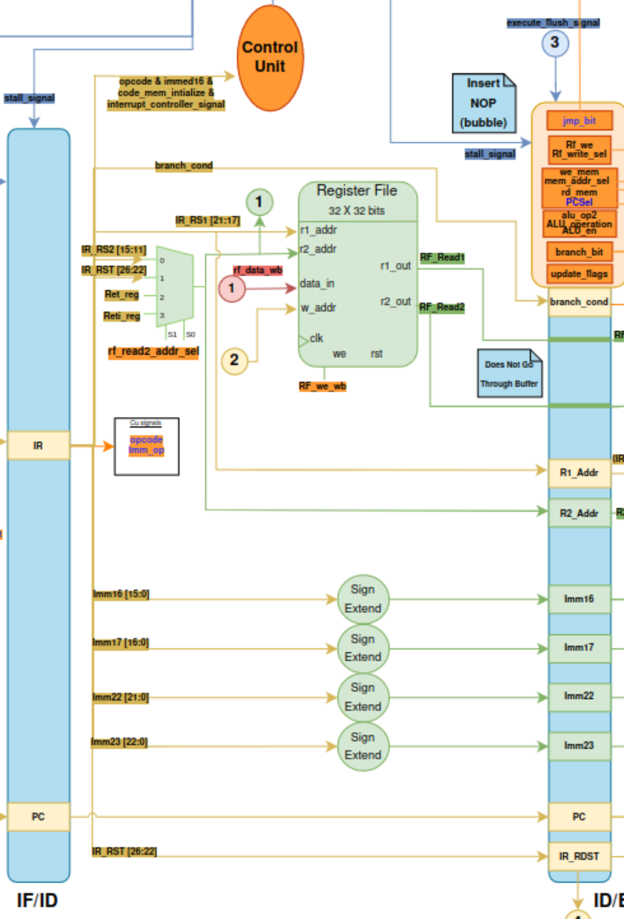
Design
Decode stage
Register file
Control Unit
Signal extension
All the data resulting from the decode stage will be stored in the stage's register file and will be used by the following stages.
Notes:
Fredo

Slide 4
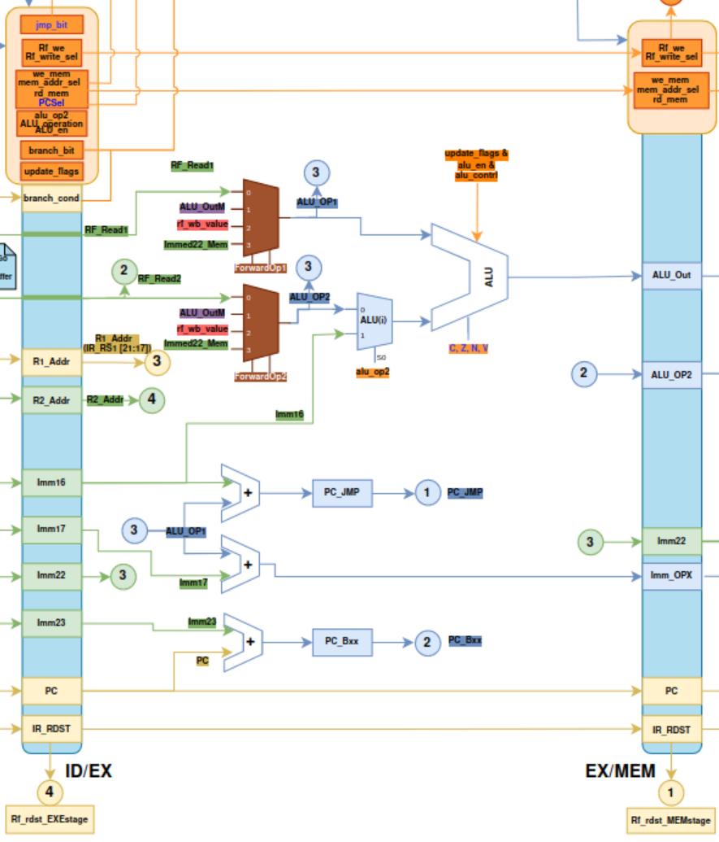
Design
Execute stage
The execute stage will utilize the hazard unit (forwarding) when necessary. That will be useful when the register pretended to use will only be written in the next MemStage or WBStage, in this case the execute stage doesn’t have the updated register value.
Notes:
Fredo

Slide 5
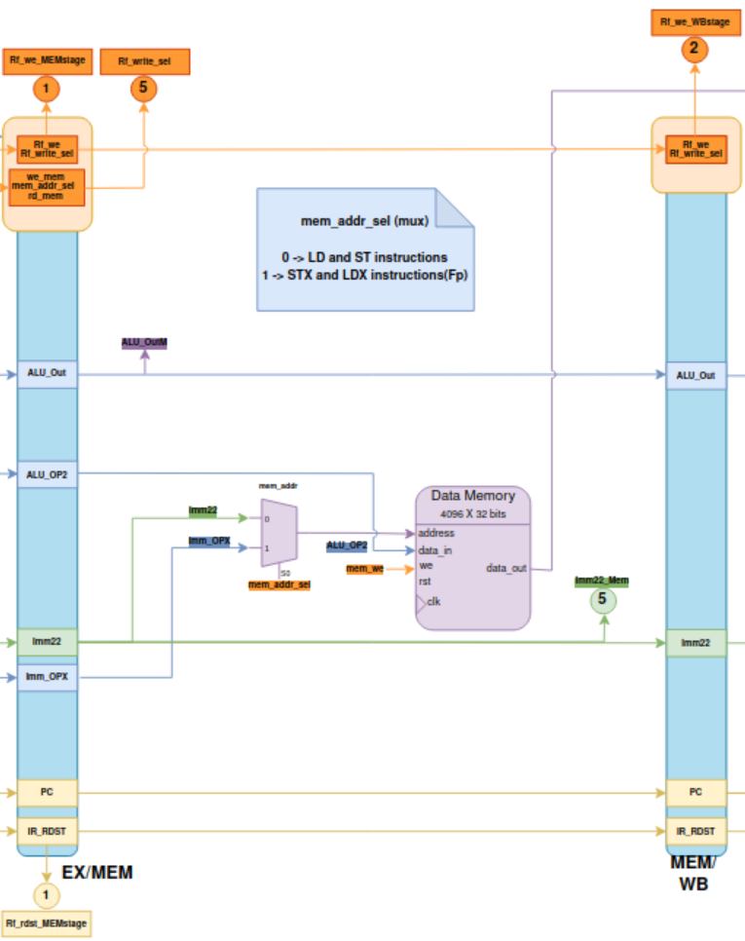
Design
Memory stage
The memory stage is the stage where one reads and writes to and from memory.
"Data_out" advances directly to the wb without passing through the intermediate register in order to balance the latency when reading from memory.
Notes:
Minor

Slide 6
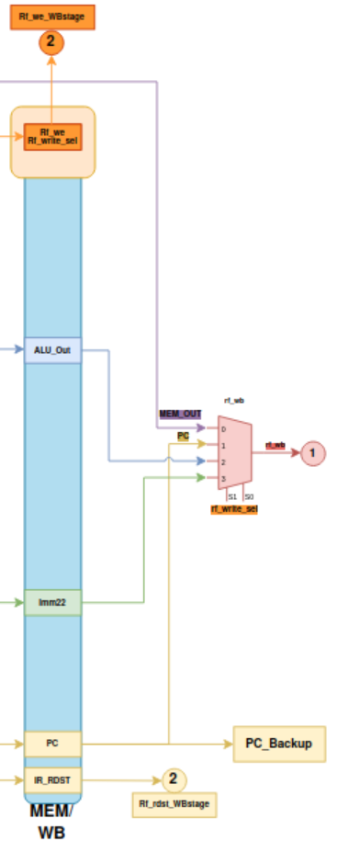
Design
Write back stage
The write back stage is the stage where you write a value for the register file.
Notes:
Minor

Slide 7
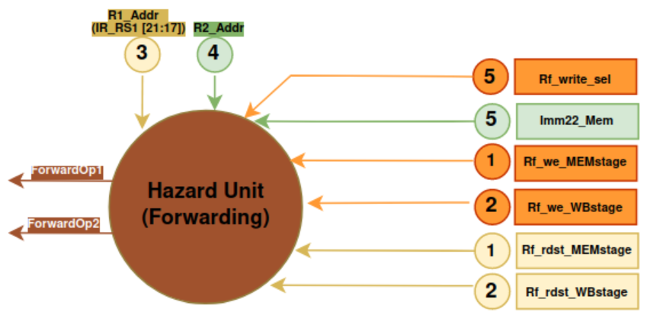
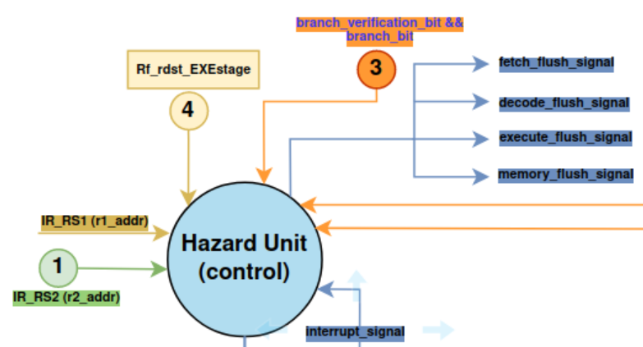
Design
Hazard Unit (forwarding)
When you need to read a register that is not yet updated
Example 1
LDI R1, #4
ADD R2, R1, #1
Example 2
SUBB R1, R2, #1
ADD R3, R1, #10
Hazard Unit (control)
The cpu will use the hazard unit (control) to do the stall and the flush to the pipeline.
Notes:
Minor

Slide 8
Design
Stall
Stall will be required for any instruction after LD when both instructions use the same register. When a stall is required, will be injected a NOP into the pipeline. Fetch and decode will be preserved although the others stages will advance.
Example:
LD R5, 100
ADD R7, R5, #2
In this case would stay:
LD R5, 100
NOP
ADD R7, R5, #2
Notes:
Marcelo

Slide 9
Design
Flush
Branch Instruction
Jmp Instruction
Ret/Reti Instruction
Interrupt attending
The flush signal is useful when it is necessary to stop and delete the instruction that is in the pipeline at that moment.
In this implementation, is used the always not taken branch technique. So, when a branch is valid, it will be necessary to flush the instruction that is currently in the fetch stage. For this, the control unit will send a control signal to the hazard unit.
Notes:
Marcelo

Slide 10
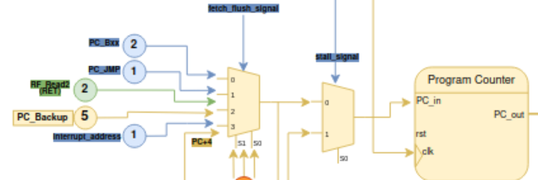
Interrupt controller
For interrupt handling it was necessary to make changes in some stages.
Whenever there is an interrupt request, the following steps will be taken:
Goes to state S_INT on the control unit;
The control unit sends the ackAttended signal to the interrupt controller;
Flush the fetch, decode, execute stages;
The value of the return address will be stored in a shadow register so that when the RETI instruction is encountered, this value will be loaded into the PC;
Notes:
Mário

Slide 11
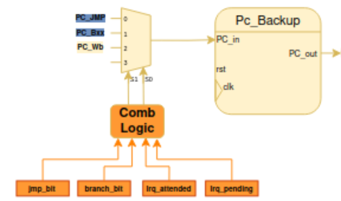
Interrupt controller
The return address will be saved in a shadow register, according to the following conditions:
When an interrupt request occurs and in the execute stage is a JMP or BXX (valid) instruction the JMP/BXX address will be saved in PC_BACKUP.
When an interrupt ends and there is another one pending, PC_BACKUP is not changed and the next interrupt is attended immediately, i.e. the RETI instruction of the first interrupt is ignored.
In the other cases, the PC of the Write Back stage is saved in PC_BACKUP.
Notes:
Mário

Slide 12

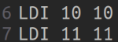
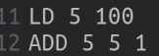
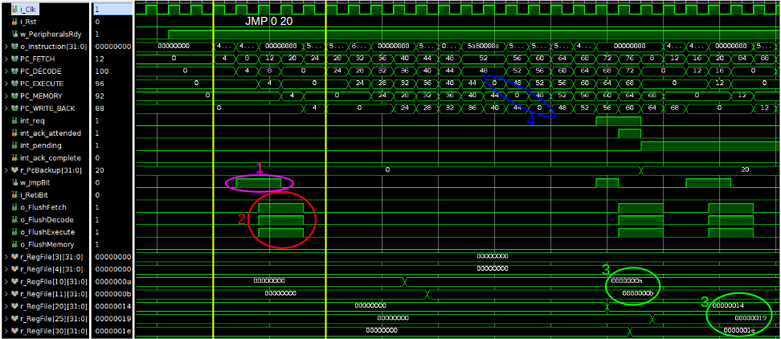
Simulation
1 - Jump bit activated
2 - Flushes signals due to JUMP instruction
3 - LDIs
4 - Stall due to one LD followed by one ADD
Notes:
Zé

Slide 13
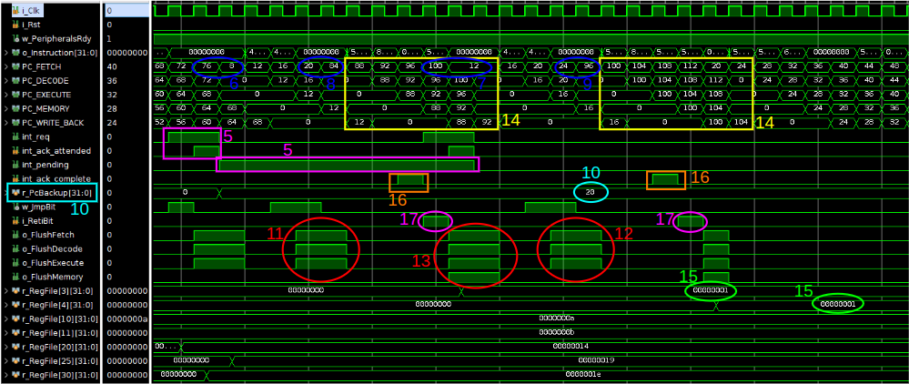
Simulation
5 - Interrupt request, ack attended and interrupts pending signals
6 & 7 - Jumps to the JMP instructions addresses for interrupts
8 & 9 - Jumps to the interrupt addresses
10 - PC backup (save the jump address because the interrupt is attended when is executing the JMP instruction)
11 & 12 - Flushs for interrupt attending
13 - Flush due to RETI
17 - RETI signal activated
Notes:
Zé

Slide 14
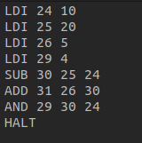
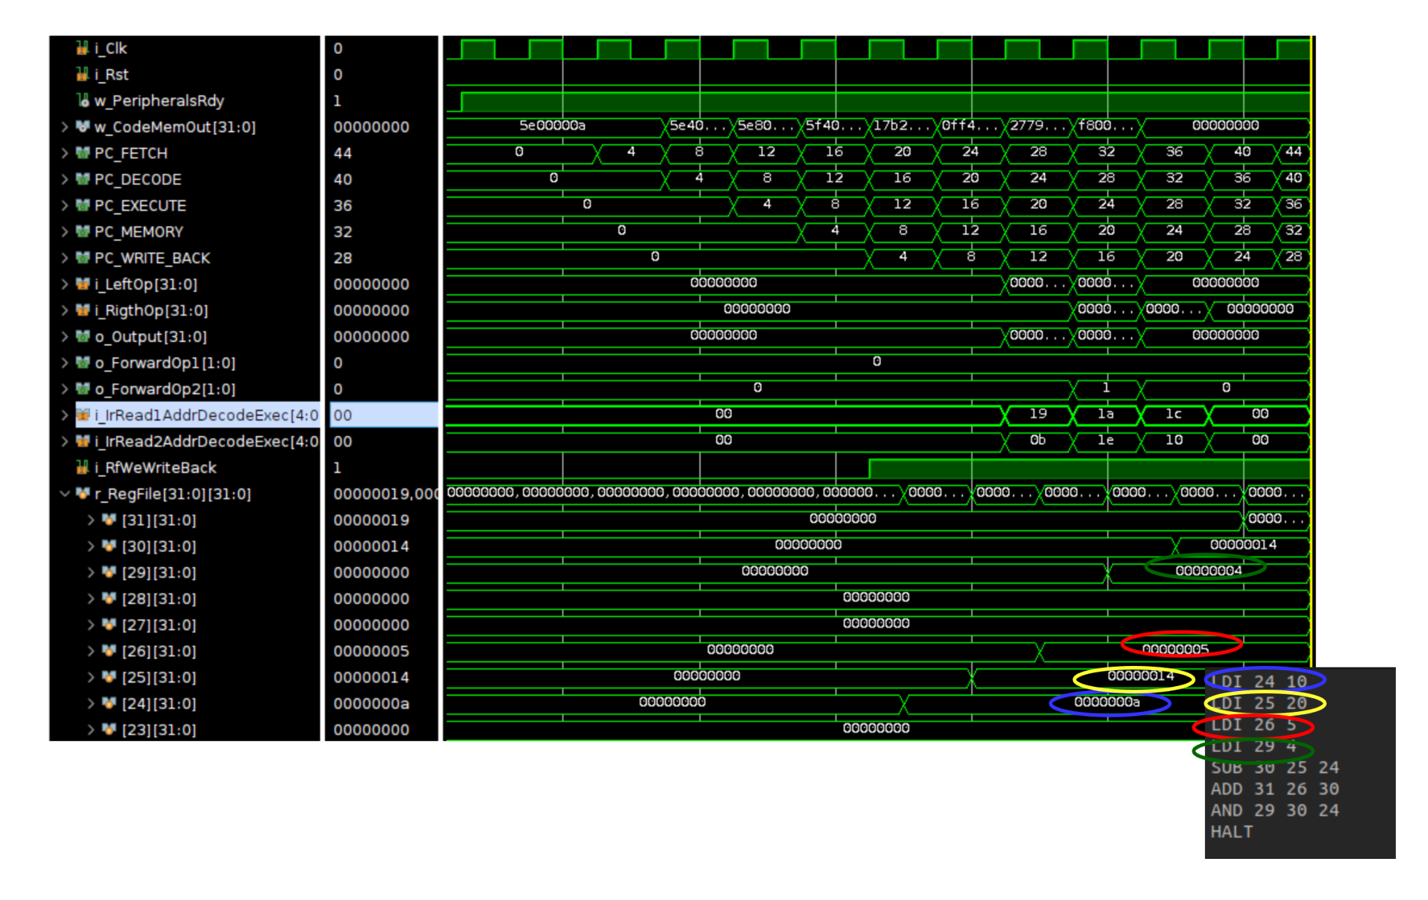
Simulation
1 - Load the 24, 25, 26 and 29 with the values
Notes:
Luiz

Slide 15
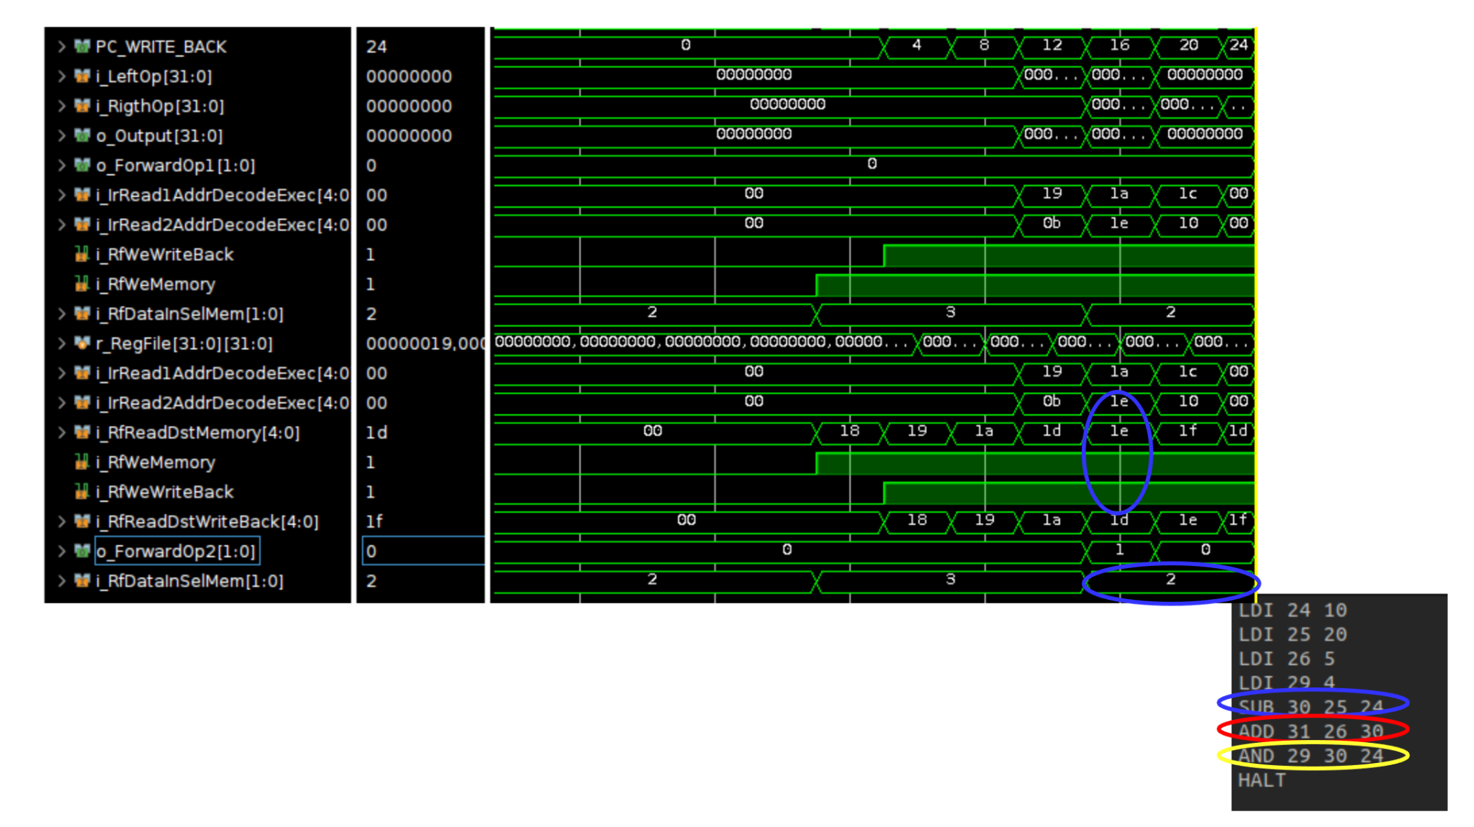
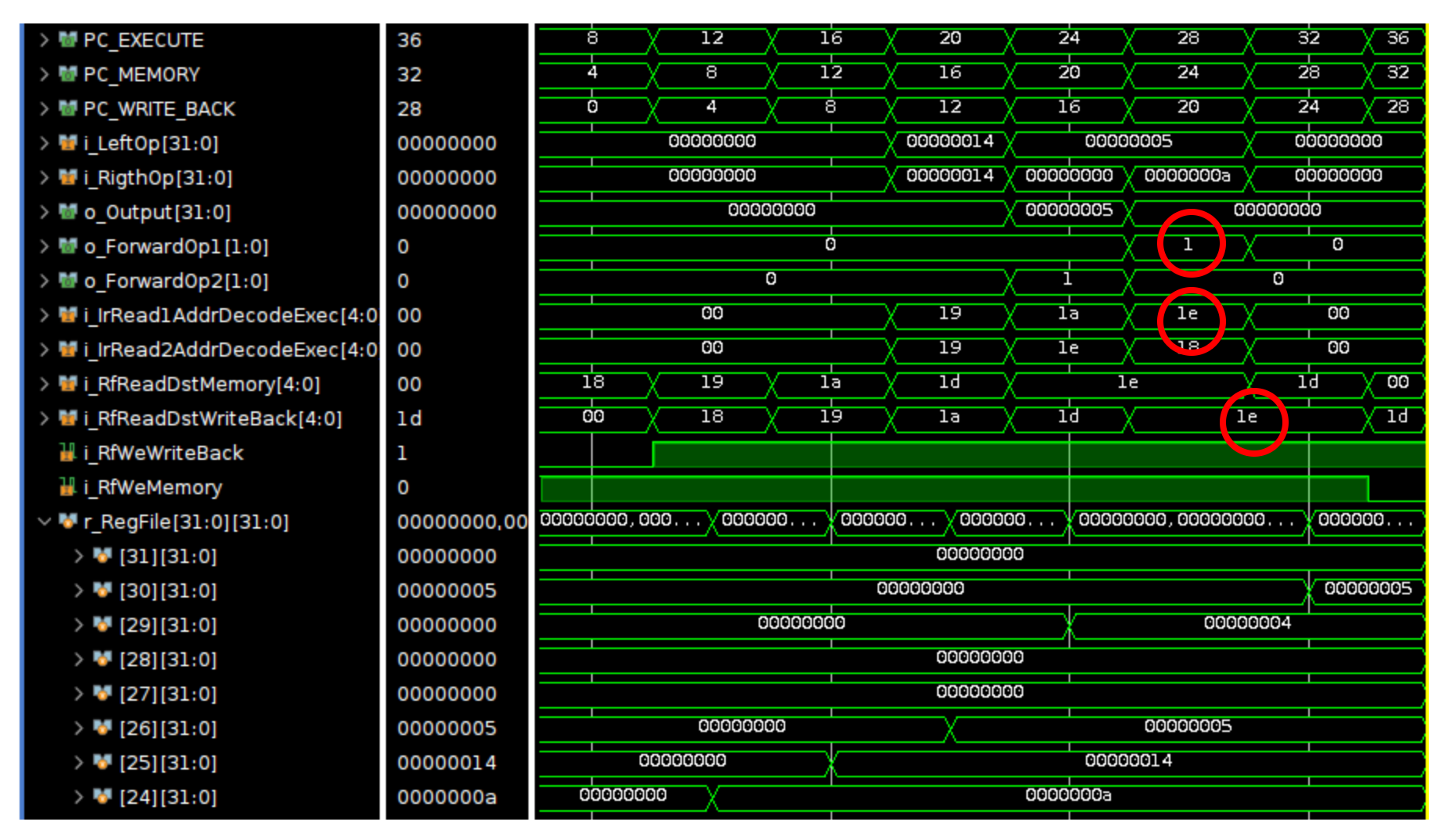
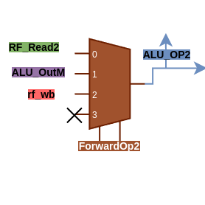
Simulation
2 - Sub operation with the 25 and 24 registers
3 - The ForwardOp2 changes to ‘1’ 4 - And instruction
Notes:
Luiz

Slide 16
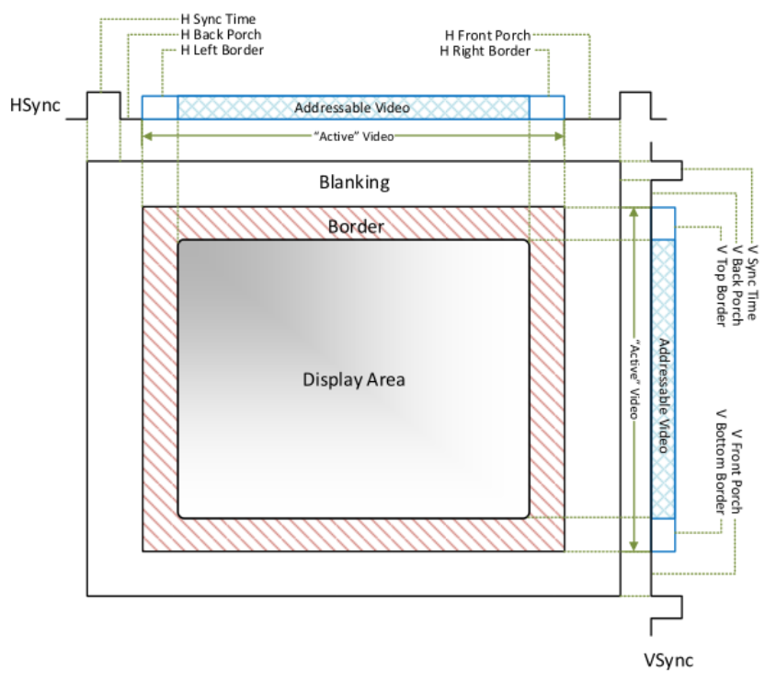
VGA analysis
VGA supports a variety of resolutions, ranging from 640x480 pixels to 1920x1200 pixels (we will only implement 640x480);
VGA uses 3 4-bit wide color signals: Red (R), Green (G), and Blue (B);
Horizontal sync signals indicate the beginning of each new scan line;
Vertical sync signals indicate the beginning of each new frame;
Notes:
Manel /Leal

Slide 17
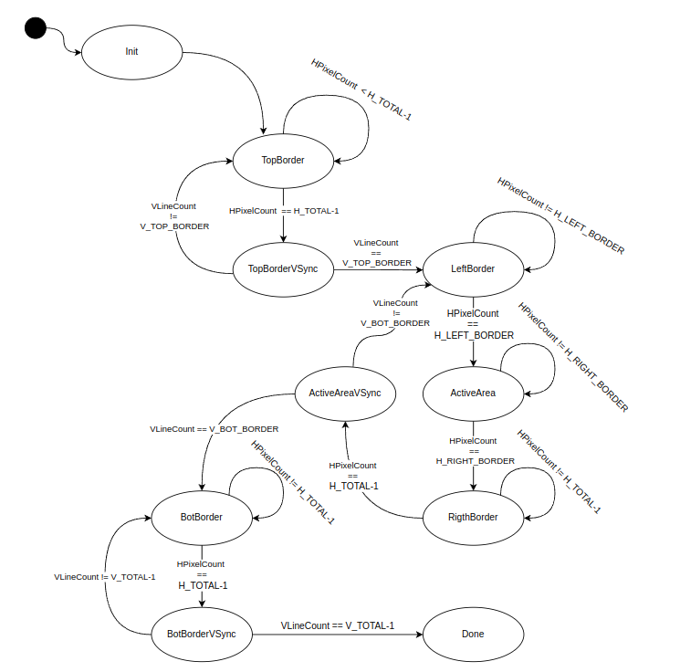
VGA design
Notes:
Manel / Leal

Slide 18
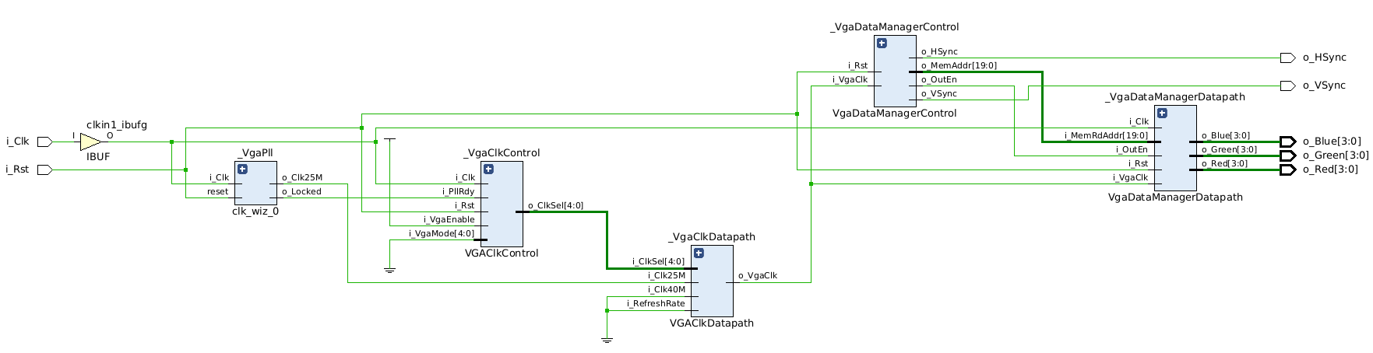
VGA schematic
VGA Clock
VGA Data
Notes:
Manel / Leal

Slide 19
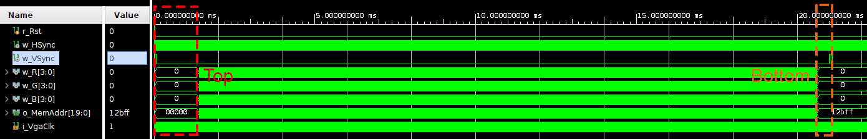
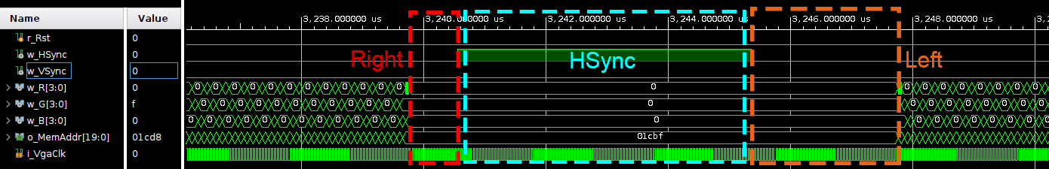
VGA simulation
Border generation:
Top and bottom borders + vertical sync
Left and right borders + horizontal sync
Notes:
Manel / Leal

Slide 20
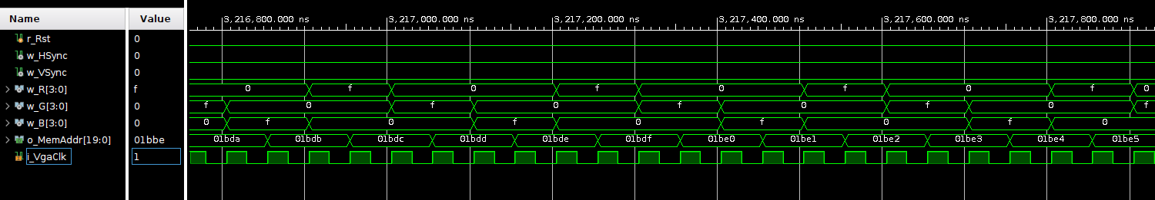
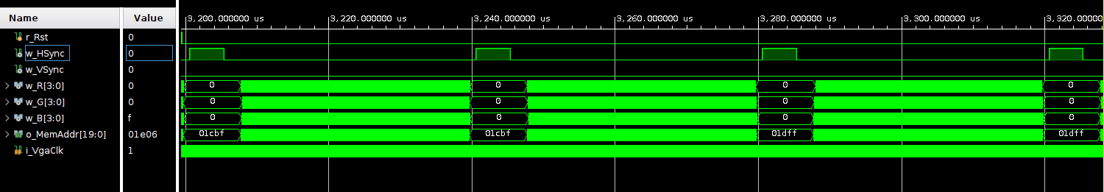
VGA simulation
RGB Values:
Notes:
Manel / Leal

Slide 21
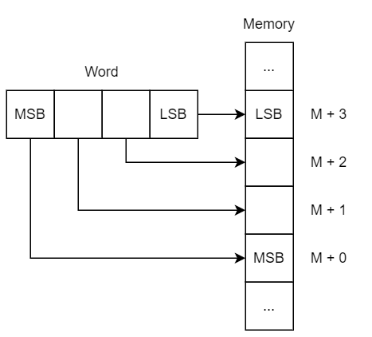
ABI
An Application Binary Interface (ABI) defines a standard set of rules and conventions that govern how program modules interact at the binary level. Among many things, it specifies how functions are called, how data is represented in memory and how errors are handled.
The ABI only supports big-endian.
Notes:
Gonçalo

Slide 22
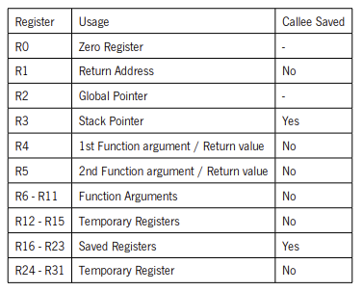
Register Calling Convention
Registers:
Notes:
Gonçalo

Slide 23
Register Calling Convention
R0 to R3 - Special Functions Registers
Each one will perform a specific function
R4 to R11 - Argument passing and returning
Used to pass arguments to functions up to 8 arguments, with only R6 and R7 used to return.
R12 to R15 and R24 to R31 - Temporary Registers
Registers to be used during execution to hold temporary values as operands and intermediate results;
Not preserved across function calls.
R16 to R23 - Saved Registers
Register used to store critical data that needs to be preserved during the execution of a program
Preserved across function calls.
Notes:
Gonçalo

Slide 24
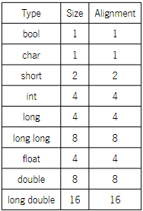
Data Types
C/C++ Fundamental Data Types:
Array
Alignment of an array is the same of its base type;
Size is the number of elements times the size of its base type.
Notes:
Gonçalo

Slide 25
Procedure Calling Convention
Function Prologue:
Place arguments;
Save return address register R1 and temporary registers, if necessary;
Jump to function, using the JUMP instruction;
Preserve saved registers;
Will be responsible for saving the PC value in the stack
Function Epilogue:
Place result in return registers;
Restore saved registers;
Restore program to before function was called, using the RET instruction;
Restore return address register R1 and temporary registers if they were saved.
Notes:
Roberto

Slide 26
Procedure Calling Convention
Parameter Passing:
Arguments are passed through registers R6 to R13, with first argument going to R6;
Depending on size a scalar or an aggregate is passed through different methods:
32 bits or less - single argument register;
64 bits or less - two argument register;
More than 64 bits - passed through the stack and replaced in the argument list with the address:
If no registers are available, arguments are passed through the stack.
Values are returned the same manner as n argument of the same type would be passed.
Notes:
Roberto

Slide 27
Procedure Calling Convention
Stack Management:
The stack grows downwards towards lower addresses;
The first argument passed onto the stack is located at offset zero of stack pointer;
The stack pointer must remain aligned throughout procedure execution.
Notes:
Roberto

Slide 28
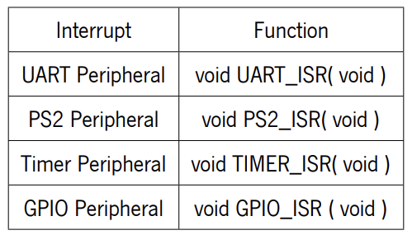
Interrupts
Interrupt Calling Procedure:
Preserve all non callee saved registers (temporary registers);
Use instruction RETI, to restore program flow, instead of RET;
The following functions signatures must be used to create the necessary instructions at the interrupt vectors:
Notes:
Roberto

Slide 29
Thank you for your attention !

